Slide 1


Python SIG Day - 1

Slide 2
AGENDA OF DAY 1
1. Introduction to Python
• Installation of Python
• Overview of Python
2. Python Basics
• Variables and data types
• Input/Output operations
• Arithmetic and logical operators
3. Control Flow
• If-else statements

Slide 3

1. Introduction to Python!
Python is a high-level, interpreted, and versatile programming language known for its simplicity and readability. It is widely used in web development, data analysis, artificial intelligence, scientific computing, and more.

Slide 4

Key Features OF PYTHON :
Easy to learn and use
Interpreted and dynamically typed
Have Extensive standard library
Cross-platform compatibility
Massive open-source community Support

Slide 5
Python Syntax, Comments, and Indentation

Slide 6
What is Python Syntax?
1. In Python, we don’t need semicolons (;) like in C++ or Java. One line = one statement
Print Statements
A simple print() statement outputs text in the terminal.
Example: print("Hello")
Output: Hello
Common Error: Placing two print() statements on the same line causes a syntax error.
Example: print("Hello") print("World") # SyntaxError: invalid syntax

Slide 7
What are Comments?
Used to write notes in code to explain what it does.
Ignored by Python → Not executed.
Start with # (hash symbol).

Slide 8
Indentation in Python
Indentation is crucial for defining code blocks (e.g., in if statements).
Example:
name = "Radha"
if name == "Radha":
print(name) # Correctly indented;
Output: Radha
Common Error: Missing or incorrect indentation. Example:
name = "Radha"
if name == "Radha":
print(name) # IndentationError: expected an indented block
In C++/Java, we use {} for blocks. In Python, indentation defines blocks.

Slide 9
Variables and Data Types in Python

Slide 10
What are Variables?
A variable is just a name we give to a value we want to store.
Python variables don’t require an explicit declaration. Their type is inferred from the value assigned to them which is called dynamic typing.
Variables can hold different data types, such as numbers, text, lists, and more.

Slide 11
Declaring Variables
In Python, declaring a variable is as simple as assigning it a value using the = operator. No need to specify its type like in C++. Python is smart enough to figure it out!
Example:
python
Copy code :
x = 10
print(x) # Output: 10

Slide 12
Variable Naming Rules:
Valid Names
Must start with a letter or underscore (_).
Can only contain alphanumeric characters and underscores.
Are Case-sensitive (Age and age are different).
Reserved keywords in Python cannot be used as variable names (Eg - print, if, else, while, for, def, class, import, True, False, None)

Slide 13
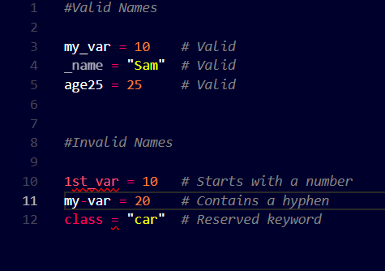
Examples

Slide 14
Data Types in Python

Slide 15
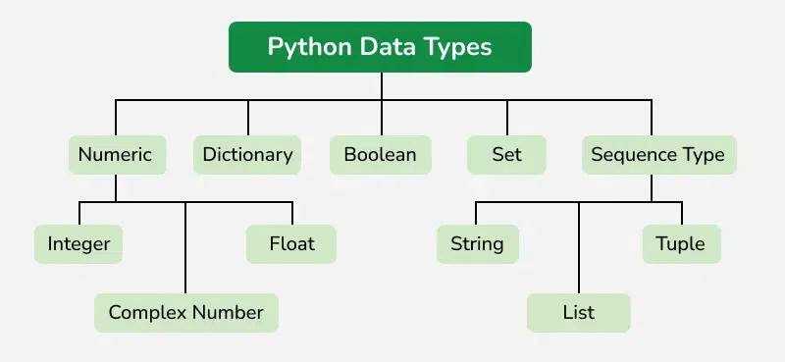

Slide 16
Numeric Data Types
Integers: It contains positive or negative numbers (without fractions or decimals). There is no limit to how long an integer value can be.
Float: It is a real number with a floating-point representation. It is specified by a decimal point.
Complex Numbers: It is represented by a complex class. It is specified as (real part) + (imaginary part)j. For example - 2+3j

Slide 17
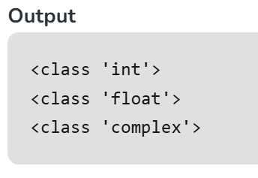
a = 5
print(type(a))
b = 5.0
print(type(b))
c = 2 + 4j
print(type(c))
Numeric Data Types

Slide 18
Sequence Data Types
Strings - sequence of characters enclosed in either single ( ' ) or double ( " ) quotes.
list:
A built-in, flexible, dynamic container.
Can hold different data types (e.g., int, str, float, etc.) in the same list.
Automatically resizes when you add or remove elements.
tuple: used to store an ordered, immutable collection of items..

Slide 19
Boolean Data Type
bool: True or False.
Booleans are most commonly used in conditional statements, comparisons, logical operations, and control flow (like if statements).

Slide 20
Dictionary
It is a data structure used to store data in key-value pairs.
Values in a dictionary can be of any datatype and can be duplicated, whereas keys can’t be repeated and must be immutable.
The dictionary can also be created by the built-in function dict().

Slide 21
Set Data Type
Set is an unordered collection of data types that is iterable, mutable, and has no duplicate elements.
The order of elements in a set is undefined though it may consist of various elements.

Slide 22
Classes and objects (class and object).
Functions can also act as data (first-class functions).
User-Defined Types

Slide 23
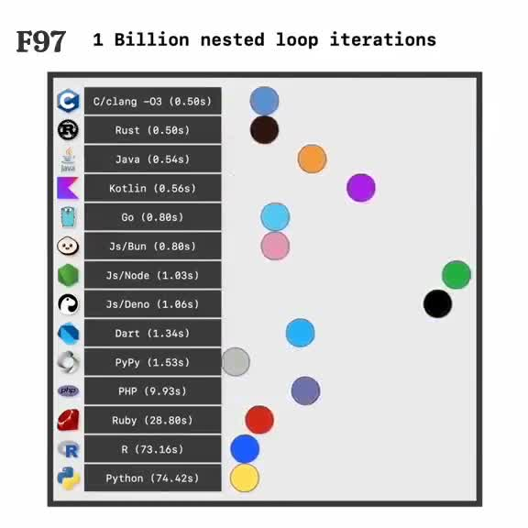
Why not DSA in Python ?
What are Variables?
Due to its slower execution time compared to compiled languages like C++ or Java

Slide 24
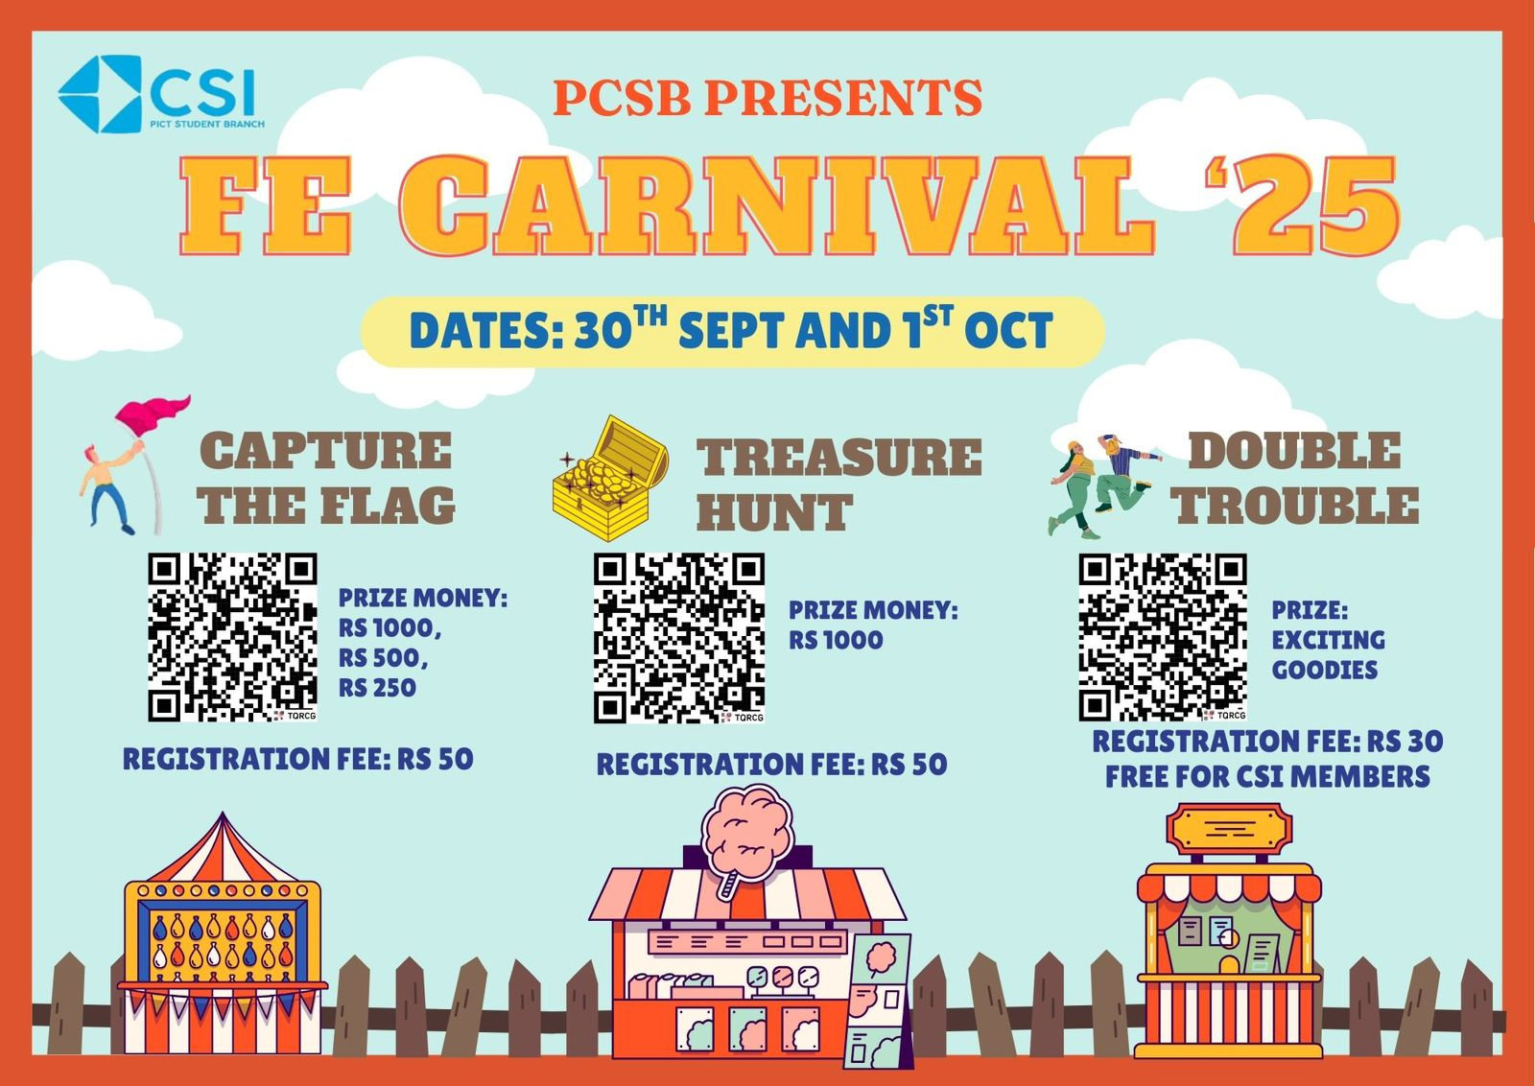

Slide 25
Python SIG Day - 2

Slide 26
Input/Output Operations
Python makes it simple to interact with users or external services using:
input() : Python takes user input from the keyboard using the input() function.
print() : Outputs information to the screen or a file.
Let’s see a example for this -

Slide 27
Input() Operation :
Syntax:
variable = input(prompt)
prompt → optional string shown to the user.
Always returns string type, even if you enter a number.
Let’s see a example for this -

Slide 28
Numeric input:
if you want an integer, float, or any other type, you need to explicitly type cast it after taking input.
Let’s see a example for this -

Slide 29
print() Operation :
Let’s see a example for this -
Difference between using , (comma) and + (plus) in print()
1. Using Comma (,)
The print() function can take multiple arguments separated by commas.
Each argument is automatically converted to a string (using str()) if it’s not already a string.

Slide 30
2. Using Plus (+)
The + operator is used for string concatenation.
Both operands must be strings, otherwise Python will throw an error.

Slide 31
Task:
Question: Greet the User
Task:
Ask the user to enter their name.
Ask the user to enter their age.
Print a message greeting the user and showing their age.
Expected Output:
Hello Prasad! You are 21 years old.

Slide 32
Operators
Operators are special symbols in Python that perform operations on values or variables
Types of Operators:
Arithmetic Operators
Logical Operators
Comparison Operators
Let’s see a example for this -

Slide 33
Arithmetic Operators :
Arithmetic operators perform mathematical operations.
Let’s see a example for this -

Slide 34
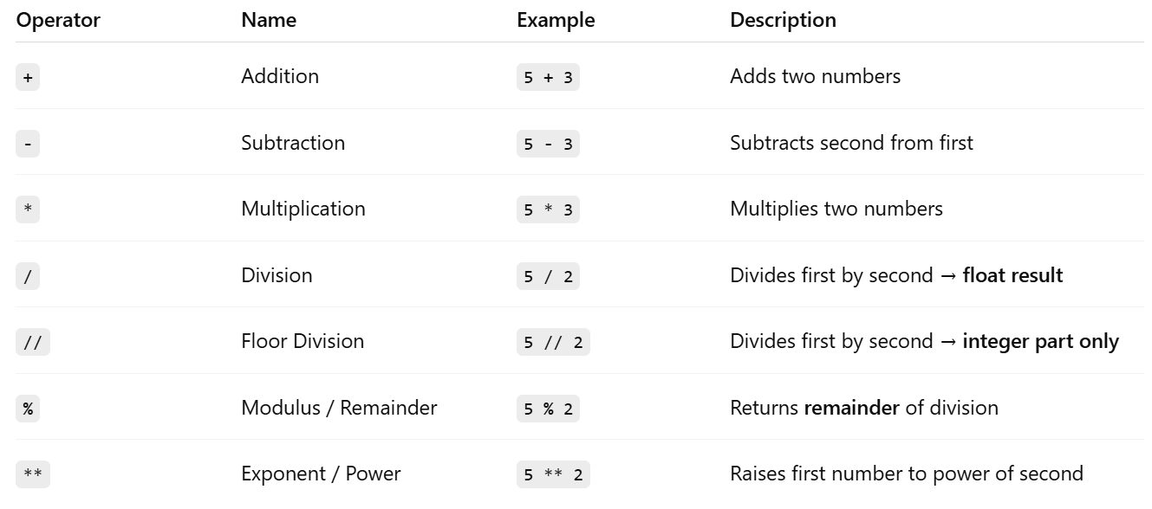
Let’s see a example for this -

Slide 35
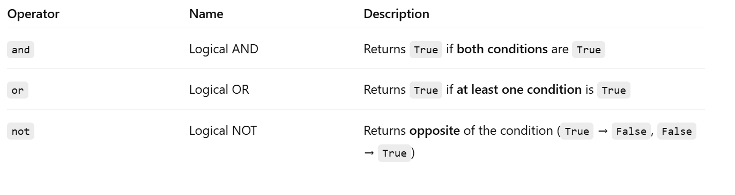
Logical Operators :
Logical operators are used to combine multiple conditions and return a Boolean value (True or False).
They are mostly used in conditional statements (if, while).

Slide 36
Comparison Operators :
Comparison operators are used to compare two values.
They always return a Boolean value: True or False

Slide 37
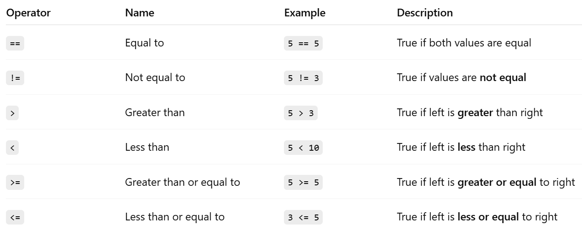

Slide 38
Type Conversion (Casting) :
Type conversion means changing the data type of a value into another data type.
Example: converting an integer to a float, or a string to an integer.
Types of Typecasting:
1. Implicit Typecasting
Python automatically converts one data type to another to prevent data loss or errors during operations.
Advantages :
Prevent Data Loss
Maintain Accuracy (Precision Handling)
Consistency in Operations
Let’s see a example for this -

Slide 39
2. Explicit Typecasting
Explicit type casting (also called type conversion) means you, the programmer, manually convert a value from one data type to another using built-in functions.
Unlike implicit casting (automatic by Python), explicit casting gives full control but can cause errors if conversion is not possible.
a) Number Conversions
int(x) → converts to integer (truncates decimal part if float).
float(x) → converts to floating-point number.
complex(x) → converts to a complex number with imaginary part 0.
complex(x, y) → makes a complex number x + yj.
Let’s see a example for this -

Slide 40
b) String Conversions
str(x) → converts any object to a string.
Useful for printing, concatenation, and file writing.
c) Collection Conversions
list(x) → converts to list.
tuple(x) → converts to tuple.
set(x) → converts to set (removes duplicates).
dict(x) → converts to dictionary (if possible, e.g., list of tuples).
Let’s see a example for this -

Slide 41
Control Flow
Control flow determines the order in which the statements in a program are executed.
In Python, not every statement is executed sequentially, we can control the flow using conditional statements and loops.

Slide 42
Types of Control Flow:
1.Conditional Statements → make decisions
if, if-else, if-elif-else
2.Loops → repeat a block of code
for loop
while loop
3. Loop Control Statements → change normal flow of loops
break, continue, pass

Slide 43
Conditional Statements
Conditional statements allow your program to make decisions and execute code only if certain conditions are true.
if statement → executes a block if condition is True
if-else statement → executes one block if True, another if False
if-elif-else statement → handles multiple conditions

Slide 44
Task:
Question: Simple Calculator
Task:
Ask the user to enter two numbers.
Ask the user to choose an operation:
1 → Addition
2 → Subtraction
3 → Multiplication
4 → Division
5 → Modulus
Perform the selected operation and display the result.

Slide 45
Loops
A loop is used to repeat a block of code multiple times until a condition is met.
Instead of writing the same code again and again, loops let us automate repetition.
for loop → used to iterate over a sequence (list, string, range, etc.)
2.while loop → repeats as long as a condition is True

Slide 46
For Loop :
Syntax :
for variable in range(start, stop, step):
# block of code
start → starting number of the sequence (default is 0)
stop → number at which the sequence stops (not included) → mandatory
step → difference between consecutive numbers (default is 1)
Key Points
stop is always excluded → range(1, 6) generates 1,2,3,4,5
step can be negative → used for reverse iteration
start and step are optional → defaults are 0 and 1

Slide 47
Task:
Question: Print Numbers
Task:
Ask the user to enter a number n.
Print all numbers from 1 to n using a for loop.

Slide 48
Nested Loop
A nested loop is a loop inside another loop.
The outer loop runs once for each iteration of the inner loop.
It’s useful when you need to perform repeated actions within repeated actions, like printing tables, patterns, or working with 2D data.
Syntax :
for outer_variable in outer_sequence:
for inner_variable in inner_sequence:
# block of code

Slide 49
Task:
Question: Print the following pattern
* * *
* * *
* * *
Task:
Ask the user to enter number of rows and column.
Print the above pattern.

Slide 50
While loop:
A while loop in Python is used to repeat a block of code as long as a condition is true.
Syntax:
while condition:
# block of code
Make sure the condition eventually becomes false to avoid an infinite loop.
Use break to exit early, or continue to skip to the next iteration.

Slide 51
Task:
Question: Print numbers
Task:
Ask the user to enter a number n.
Print the numbers from 1 to n.

Slide 52
Loop Control Statements
Continue Statement:
The continue statement in Python returns the control to the beginning of the loop.
for letter in 'python':
if letter == 'h':
continue
print('Current Letter :', letter)

Slide 53
Loop Control Statements
Break Statement
The break statement in Python brings control out of the loop.
for letter in 'python:
if letter == 't' :
break
print('Current Letter :', letter)

Slide 54
Functions
Definition: A function is a block of reusable code that performs a specific task.
Purpose: Avoids code repetition; promotes code reusability.
Syntax: Defined using the def keyword.
Function Call: Executes the code inside the function.
Parameters: Functions can take input values (arguments).
Return: Can return a result using the return statement.
Benefits: Improves readability, modularity, and maintainability of code.

Slide 55
Functions
Syntax:
def function_name(parameters):
# body of the function
return expression

Slide 56
Functions
Types of Function Arguments:
1. Default Arguments
A default argument is a parameter that assumes a default value if a value is not provided in the function call for that argument.
2. Keyword Arguments
In keyword arguments, values are passed by explicitly specifying the parameter names, so the order doesn’t matter.

Slide 57
Functions
Types of Function Arguments:
3. Positional Arguments
In positional arguments, values are assigned to parameters based on their order in the function call.
4. Arbitrary Arguments
We can pass variable number of arguments to a function using special symbols.

Slide 58
Functions
Return Statement in Function
The return statement ends a function and sends a value back to the caller. It can return any data type, multiple values (packed into a tuple), or None if no value is given.
Syntax:
return [expression]
return ends the function, [expression] is the optional value to return

Slide 59
Functions
Global and Local Variables in Python
1.Local Variables:
Local variables are created inside a function and exist only during its execution.
They cannot be accessed from outside the function.
2.Global Variables:
Global variables are declared outside all functions and can be accessed anywhere in the program, including inside functions.

Slide 60
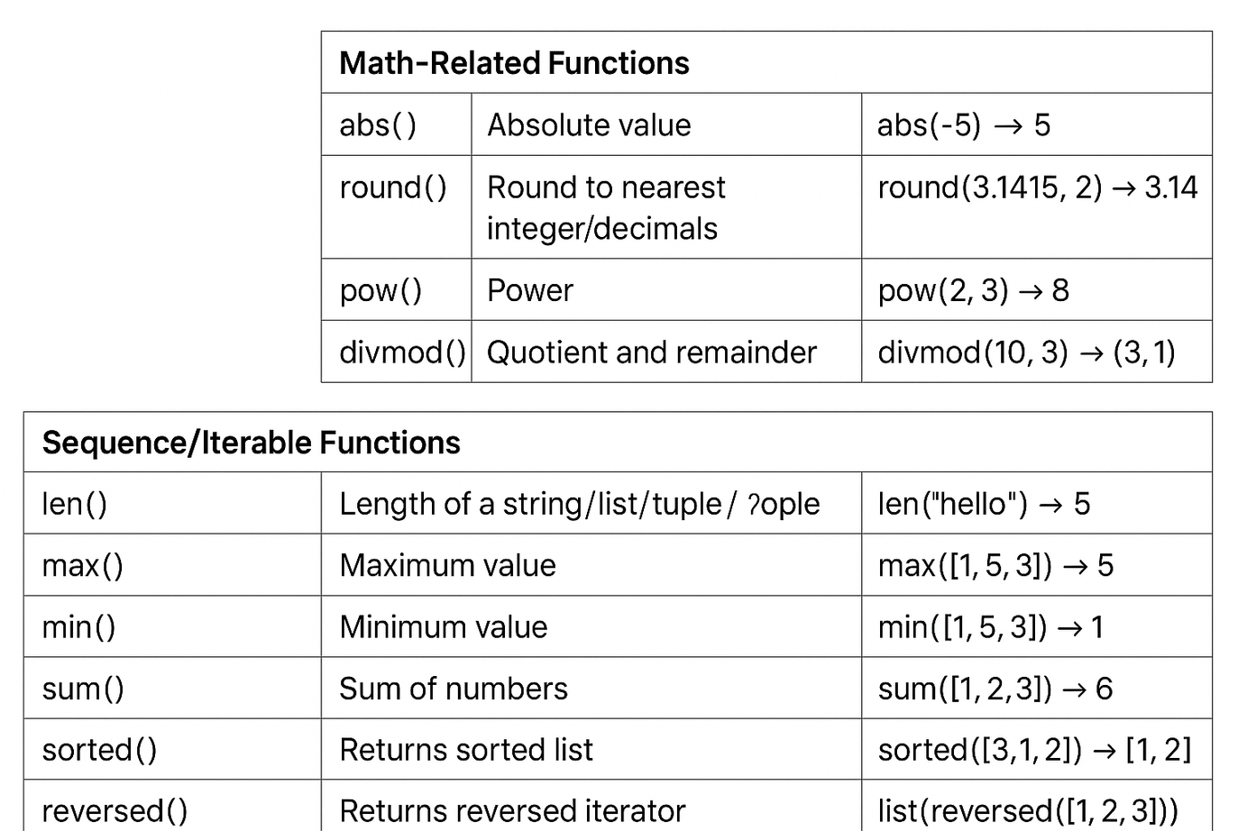
Functions
Built-in functions:

Slide 61
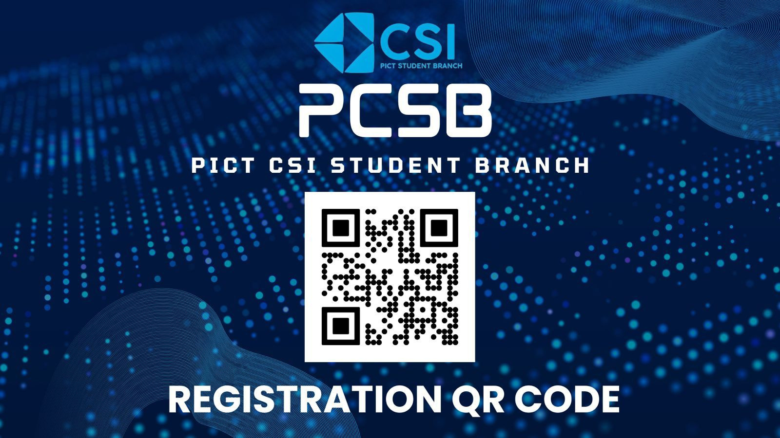


Slide 62
Assignment

Slide 63
Thank You !!

